Slide 1
AIR BNB Data Analysis
-Narayan patil

Slide 2
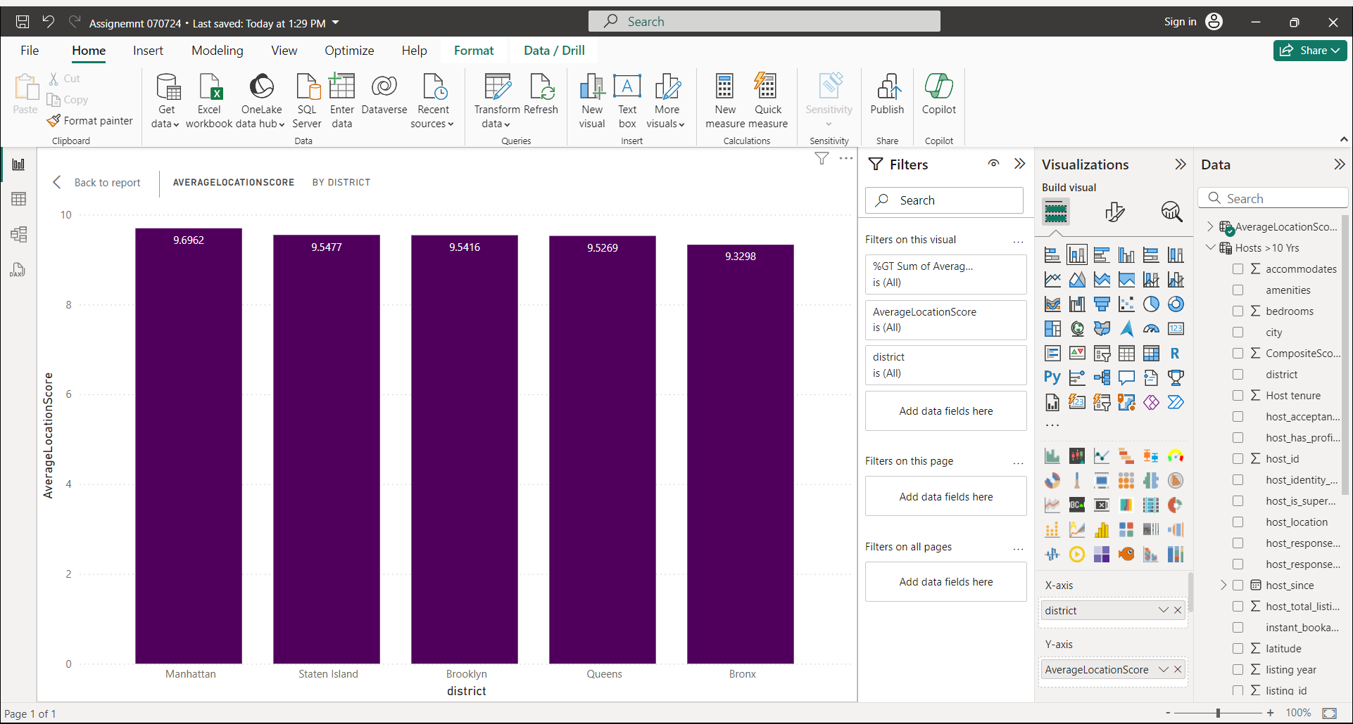
District location Scores
District Bronx has got the least favourable location score

Slide 3
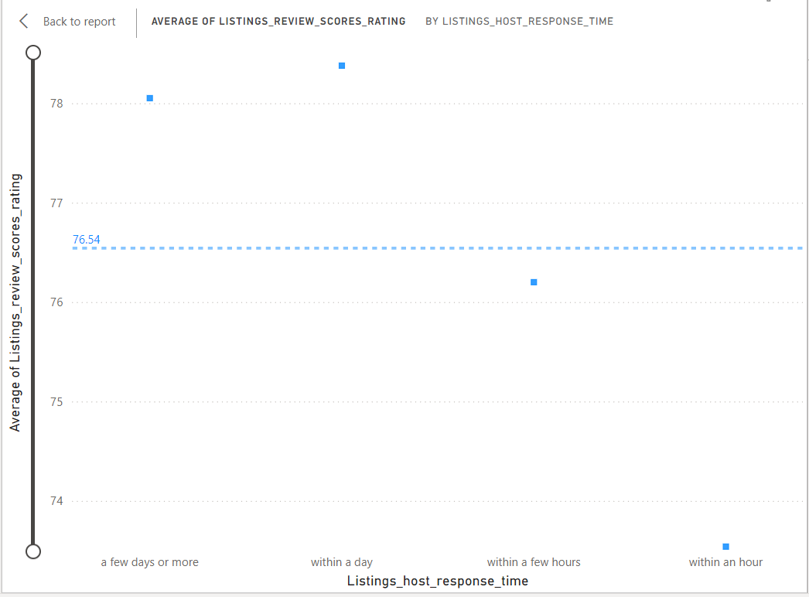
Examining Host Response Time Impact

Slide 4
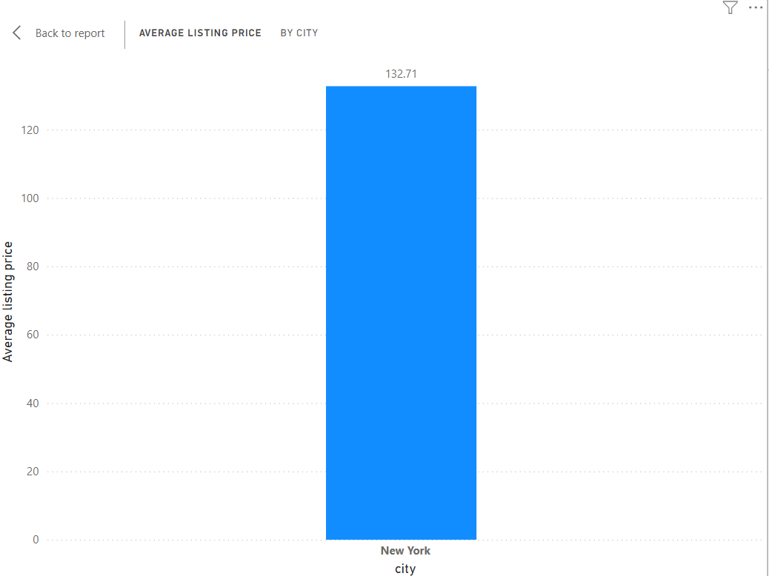
Average listing price by city
Since there is only one city the average is 132.71

Slide 5
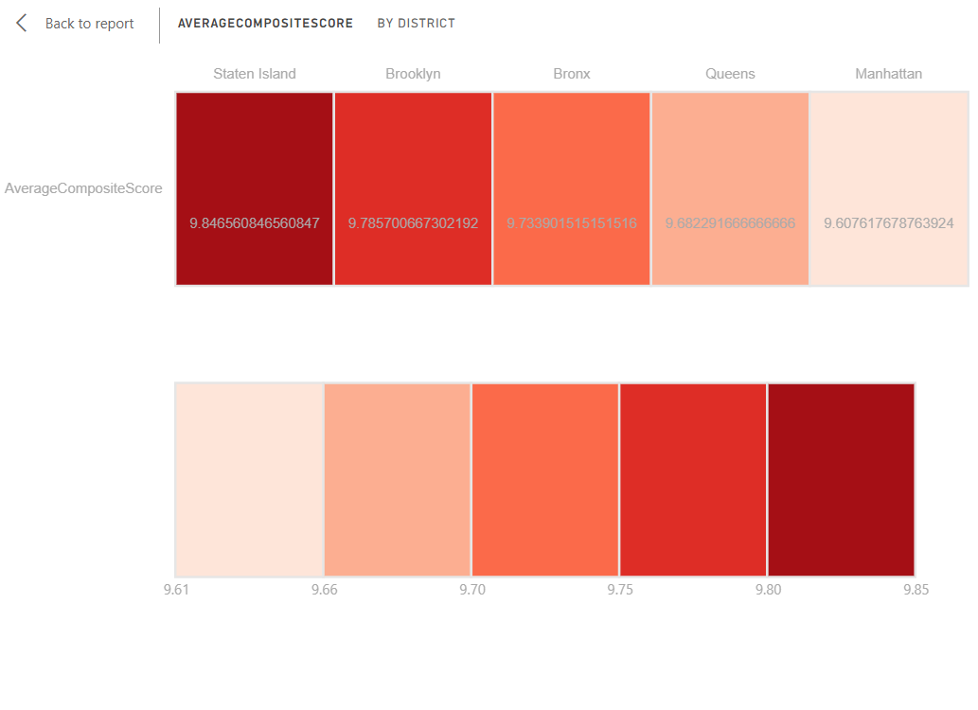
Average Composite Scores
Staten Island has the highest Composite score and least is Manhattan

Slide 6
District location Scores
District Bronx has got the least favourable location score

Slide 7
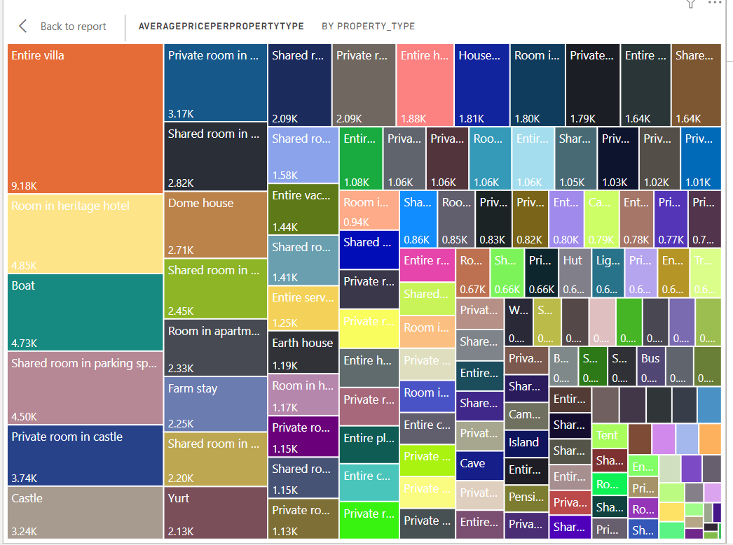
Property Type Price Analysis
Highest Average price is for Entire villa and lowest is for shared room in tent

Slide 8
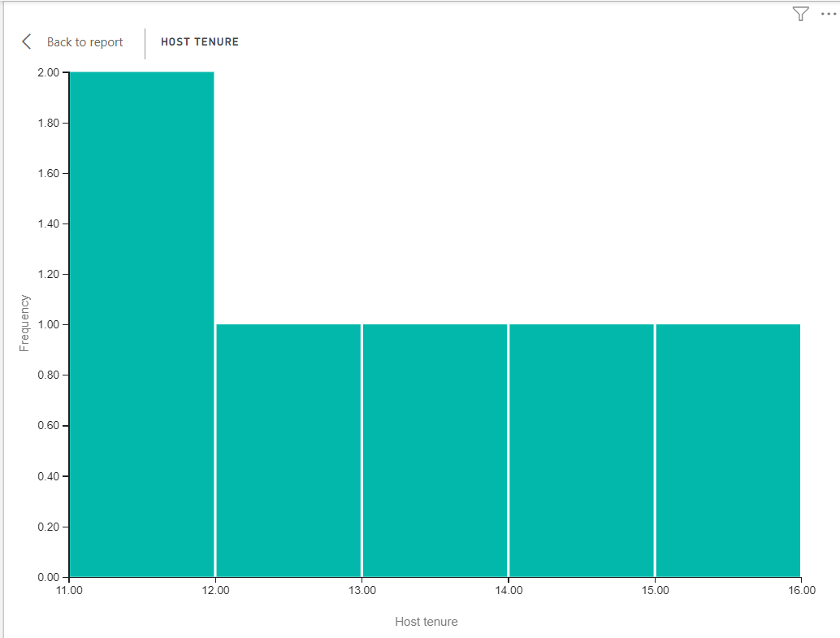
Listing age and host tenure
3687 hosts have accumulated more than 10 yrs hosting experience

Slide 9
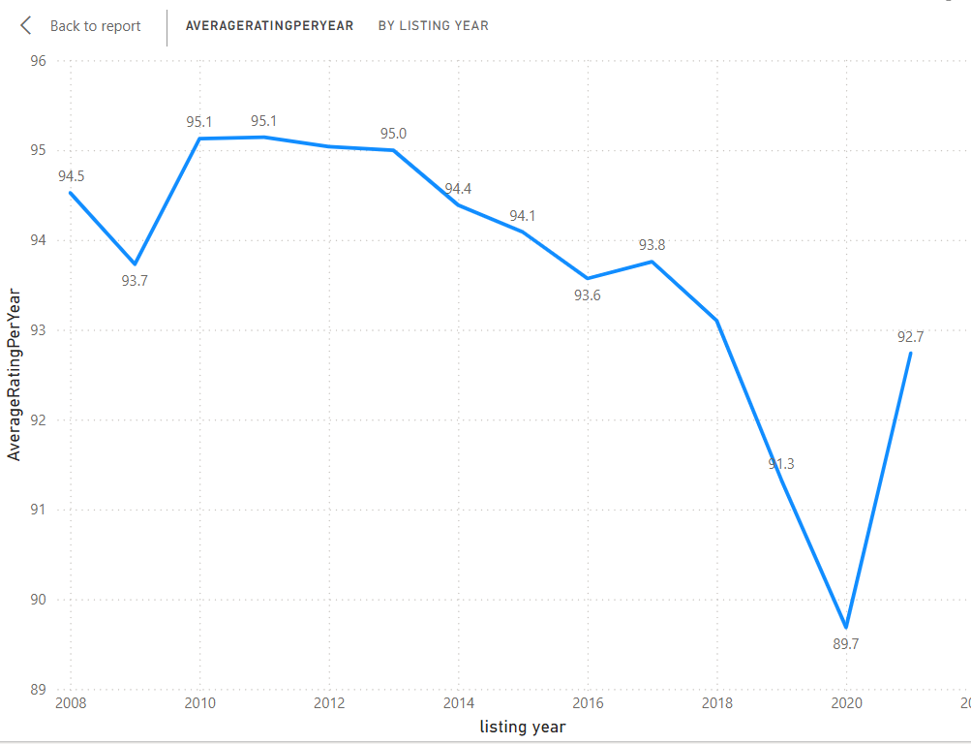
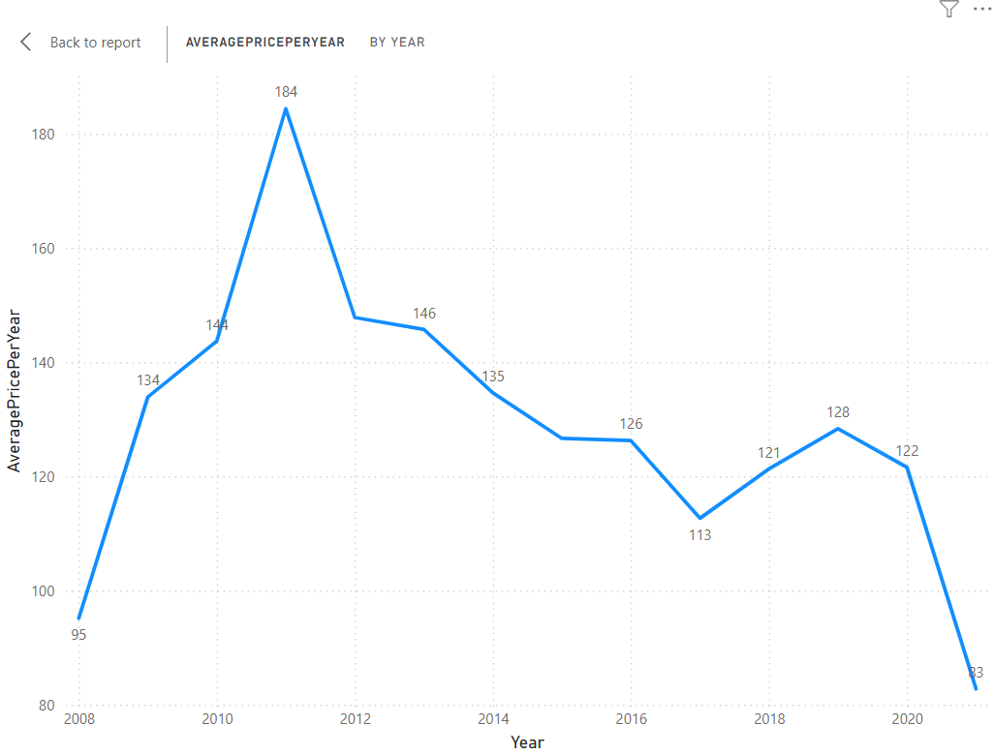
Comprehensive Insights Report
3687 hosts have accumulated more than 10 yrs hosting experience

Slide 10
THANK YOU

